Slide 1
GDA Project : 3D Gaussian Splatting
Pierrick Bournez, Amruth Srivathsan ,
Paul Tabbara

Slide 2
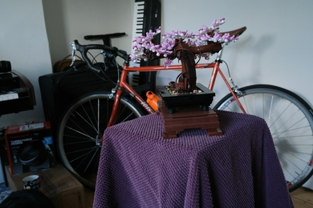
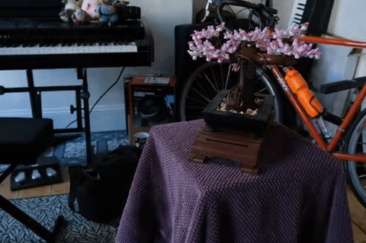
Problem: From a Series of Images, Create a 3D reconstructed scene
Numerous applications in robotics, Virtual Reality…
Notes:
Presentation:Pierrick
Our problems is : Knowing a series of Images, create a 3D reconstructed scene
This is a subproblems from something more general called « Novel View Synthesis » when you want to infer

Slide 3
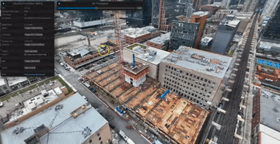
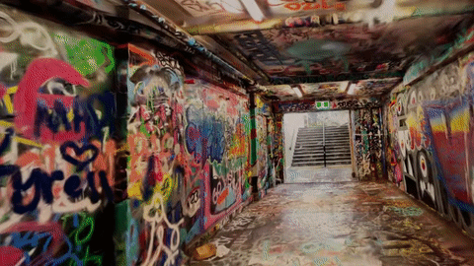
Application:
Robotics, Virtual Reality…​
Notes:
Presentation:Pierrick
It has several applications. For example Virtual reality, 3D Building Timelapse.
It could even be used as part of a bigger pipeline to replicate larger model such as Genie 2

Slide 4
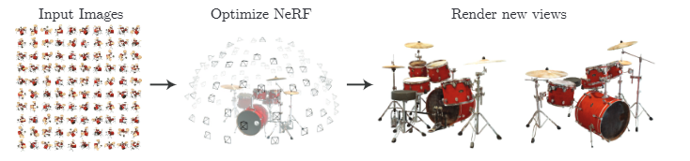
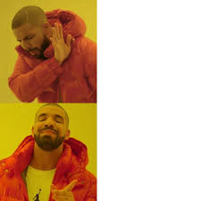
Prior Works: NeRF
(from the NeRF paper)
History:
NeRF used Deep Learning
NeRF
Drawbacks:​
Long Training time ​
Slow Inference
3D Gaussian Splatting
Notes:
Presentation:Pierrick
Originally to solve this view synthesis problem, people used NeRF. NeRF is a Deep Learning network specifically tailored for it .
However, Training of NeRF could be slow ( around 1 or 2 days) And another drawback is the slow inference due to the DL nature and heavy sampling required in inference time to render the scene .
Gaussian splatting addresses theses issue by changing the building blocks of the algorithm, from Deep Learning to 3D Gaussians .

Slide 5

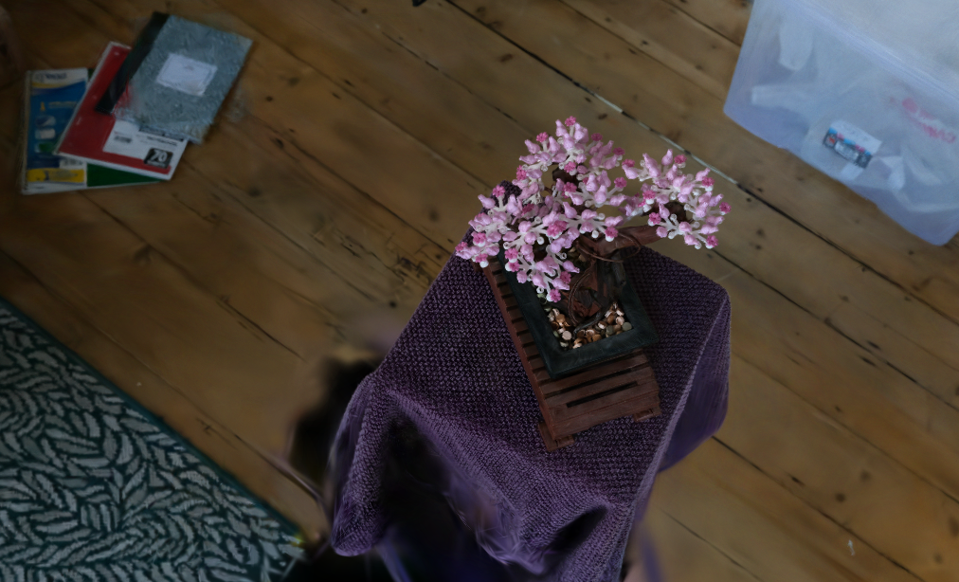
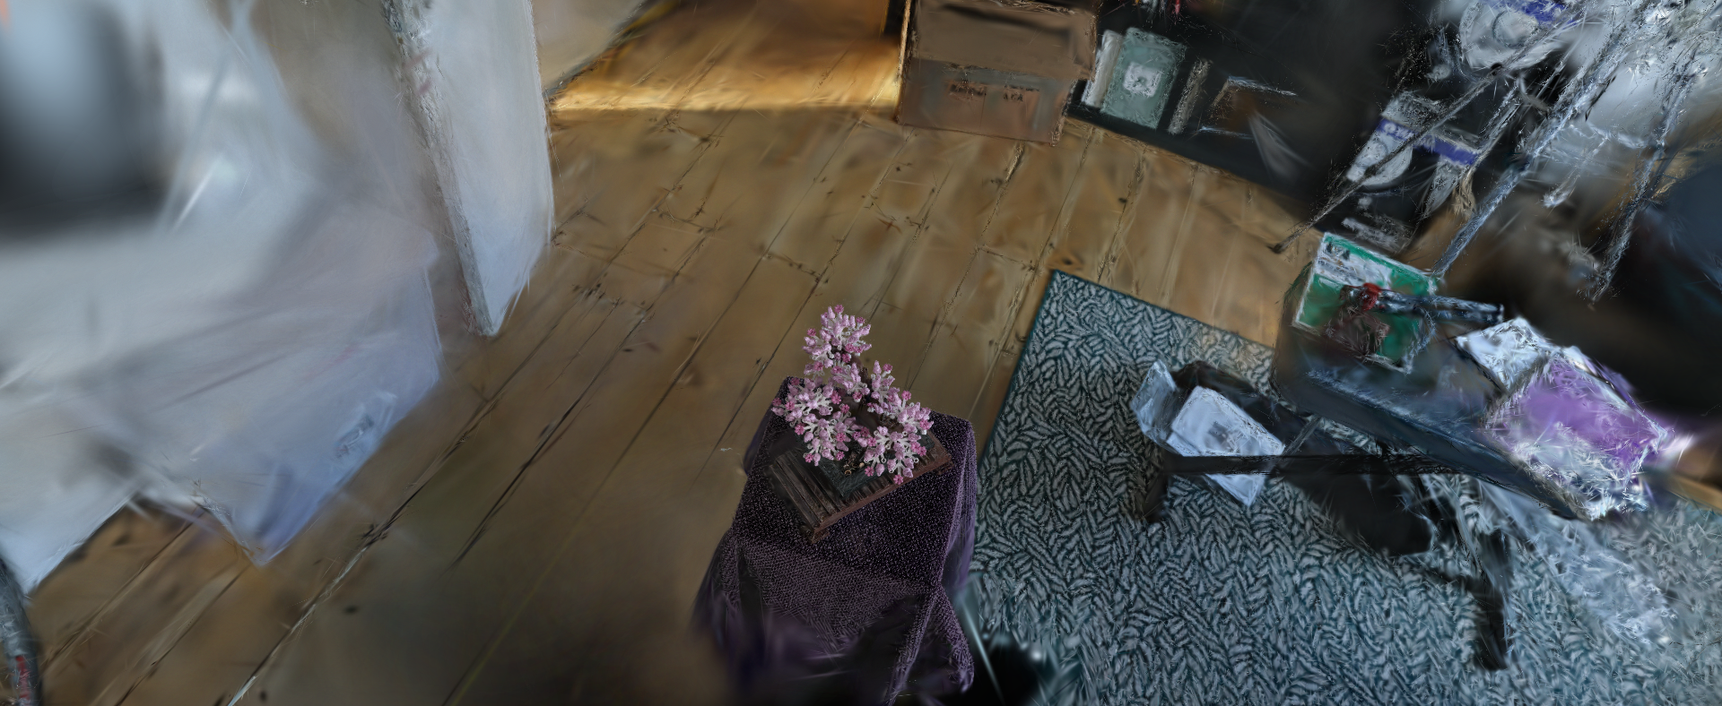
Methodology of Original Paper
Rendering
Structure
From Motion
Optimization
Input
Images
3D Gaussians
Rendered
Image
5
Notes:
Presentation:Amruth
LETS see how this is done by looking at the method of the paper. A general overview is as follows where we will look first at the Strucutre From Motion to get 3D Guassians after which we will talk about rendering and optimization techniques employed by the authors.
LETS begin with the initalization.

Slide 6
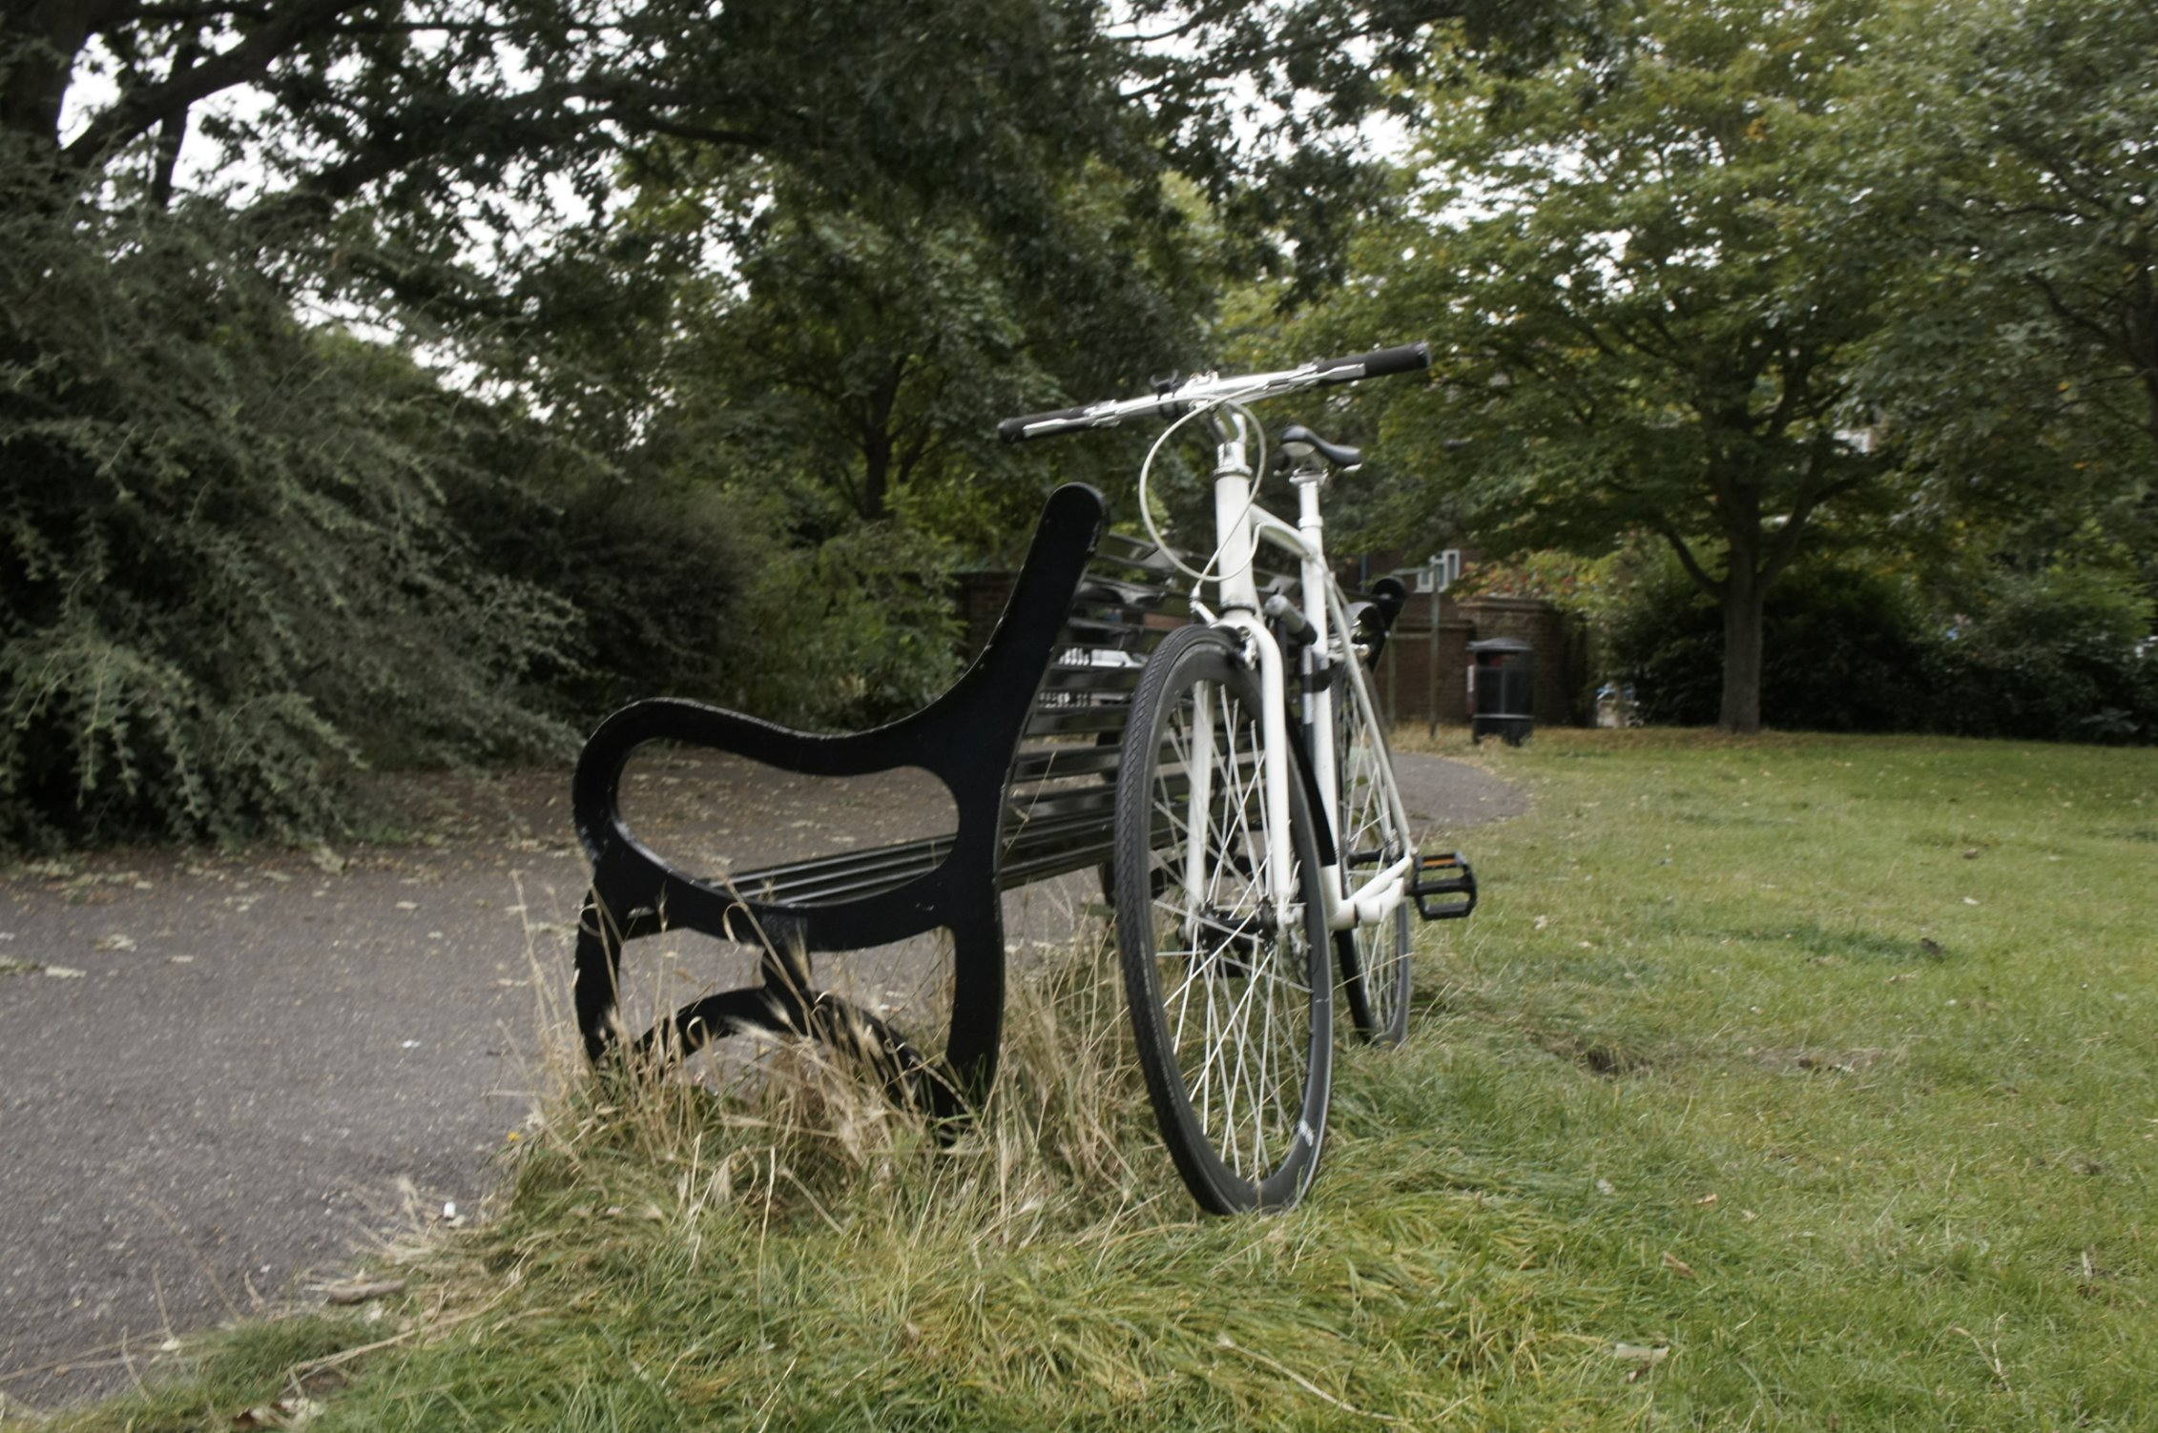
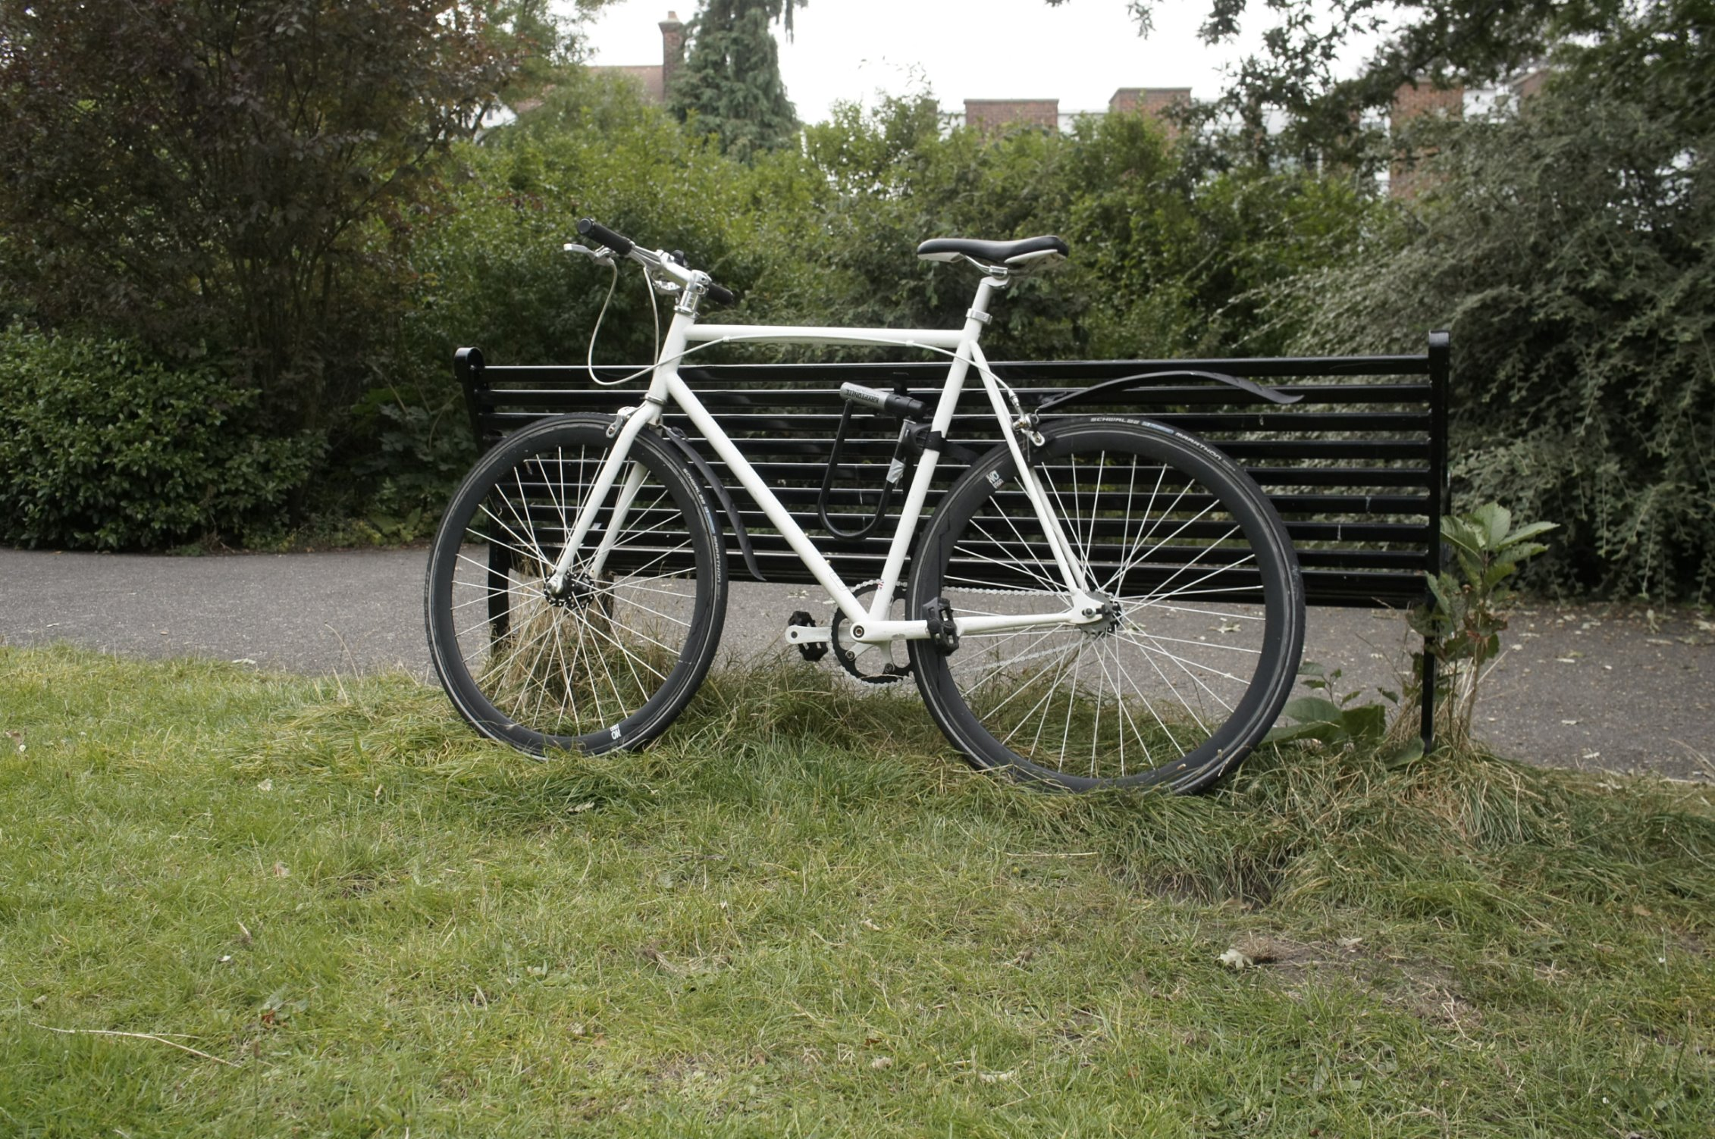
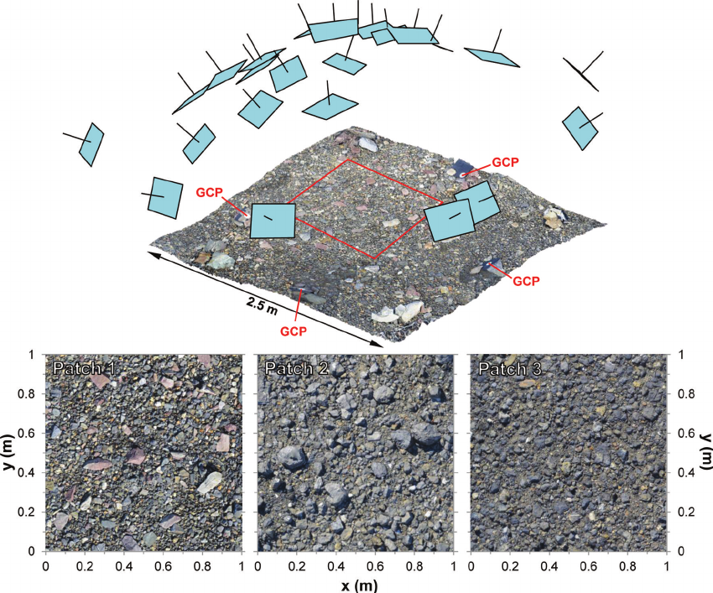
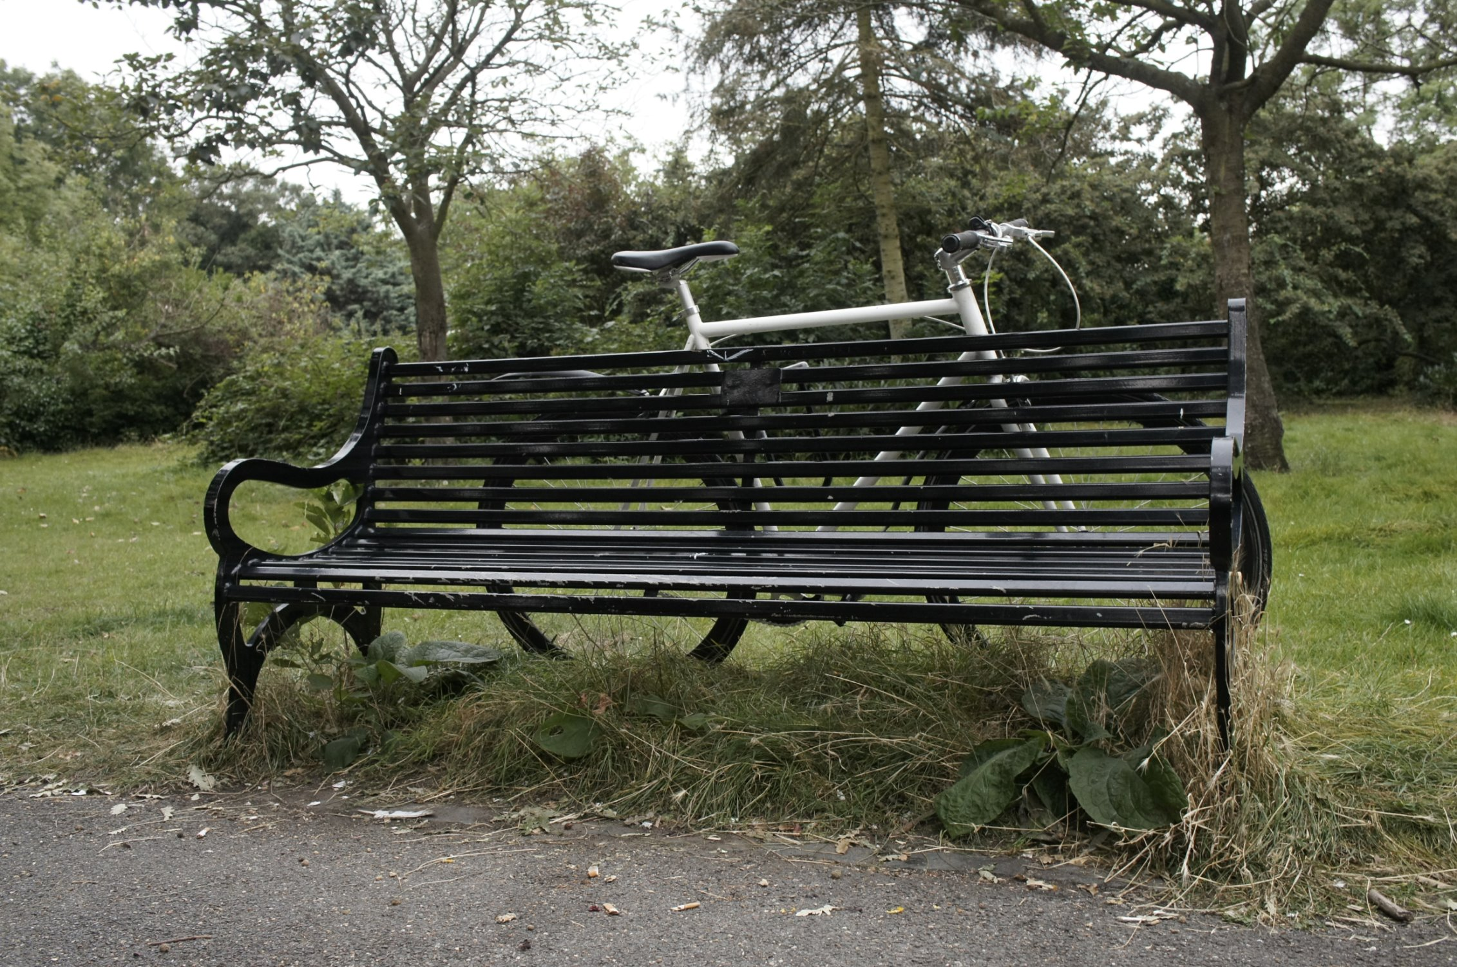
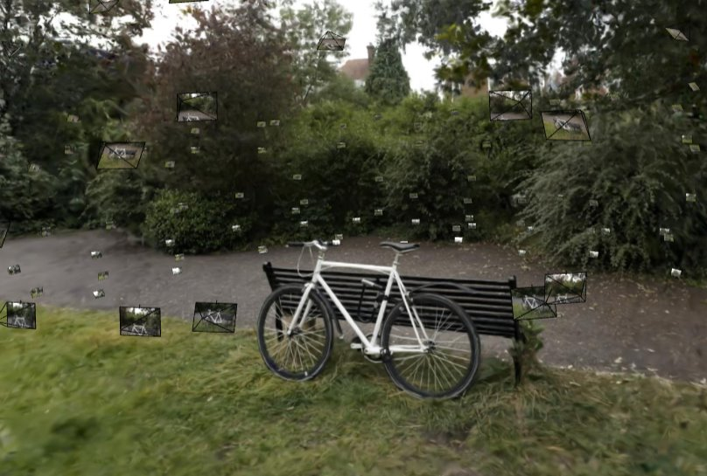
Initialization (3D scene from 2D Images)
Input: Set Of Images
Output: Set of 3D Gaussians (from SfM Points)
Notes:
Presentation:Amruth
Imagine you have a set of 2D images of an object or scene. You can sort of imagine these images as a snapshot of the 3d environment as seen in this image. The first step is to take these images and process them using Structure from Motion. SFM is a technique that analyzes multiple images from different angles and reconstructs the 3D geometry of the scene. What you end up with are sets of 3D points that represent key features of the scene, like corners, edges, and other visual landmarks.
Next, we can take these 3D points and initialize 3D Gaussians.

Slide 7
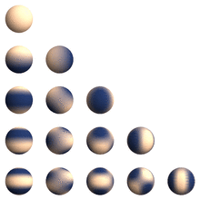
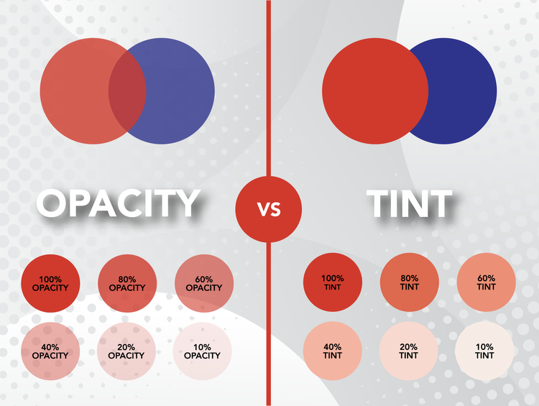
Building Block: 3D Gaussian
3D Gaussians Space Parameters:
3D positions
Covariance
Color Parameters:
Spherical Harmonics
Opacity
Color Parameters:
Visualization of spherical harmonics behaviours
Color Parameters:
Different opacity value
Notes:
Presentation: Pierrick
The main building blocks of the paper is 3D Gaussian. Those Gaussian are represented with several parameters:
First, we have the usual 3D Gaussian Space parameters. We have a mean, which is the 3D positions and a covariance matrix. As 3D Gaussians has to encode some notion of colors, we added 2 colors parameters.
First they encoded Colors into 3D Gaussians with Spherical harmonics. It allow view-dependent colors.
They added as well opacity parameters to fuse 3D gaussian colors togethers.

Slide 8
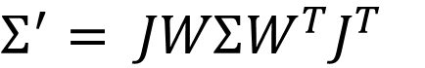
Rendering
Projection (3D → 2D):
[Special Property]
Tiling
$$Σ^{′}= JWΣW^{T}J^{T}$$
Notes:
Presentation:Paul
The powerful part of using THESE 3D guassians is that they have the Special Property where the 3D Gaussians can be easily projected as 2D Gaussians via THIS projection Scheme.
While NeRF has to run costly neural inference for each new camera position, this framework allows for a fast rendering as it only requires computing gaussian projections into the camera plane.
From a 2d gaussian projection, this rendering is done by a tile rasterizing procedure, which allows for fast paralelized computing.
For a faster training algortihm, the authors also use this technique to render training scenes and compare them to training views.

Slide 9
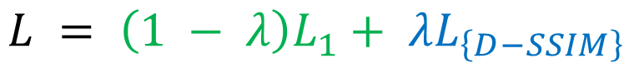
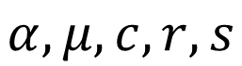
Optimization
Parameter optimization:
$$L = \left(1 − λ\right)L_{1}+ λL_{\left\{D−SSIM\right\}}$$
$$α, μ, c, r, s$$
Optimization of number of Gaussians:
Over-reconstruction:
Under-reconstruction:
Notes:
Presentation: Paul
To optimize the gaussians parameter (alpha, mu, etc..) we can use the rendered view earlier to compute loss, two terms:
a term for pixel to pixel difference
and a term that focuses on more global strctural dissimilarities
On top of optimizing gaussian parameters, the algorithm optimises for the number of gaussians.
If gaussians fail to reconstruct a shape precisely enough, it creates subgaussians to better fit the shape (in both cases where it is too big or too small)

Slide 10
Limitations and Extensions
Notes:
Presentation:Amruth NOW LET US LOOK AT LIMITATIONS AND EXTENSIONS WE WORKED ON

Slide 11
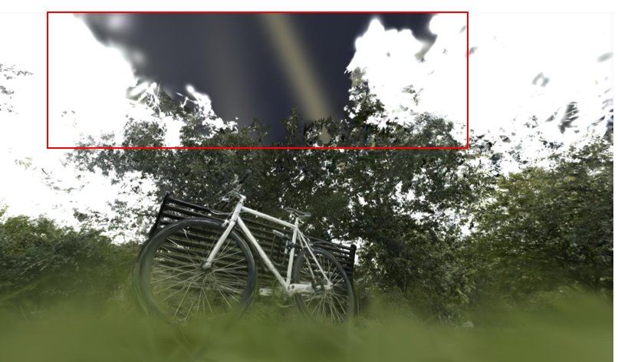
Limitation 1 :Holes Due to Missing Camera Views
Notes:
Presentation:Amruth
A key limitation of Gaussian splatting in 3D reconstruction is the appearance of "holes" or black patches in areas not observed by the training camera. This occurs because the algorithm relies on multiple viewpoints to build the scene, and regions outside those views lack the necessary data for accurate reconstruction.

Slide 12
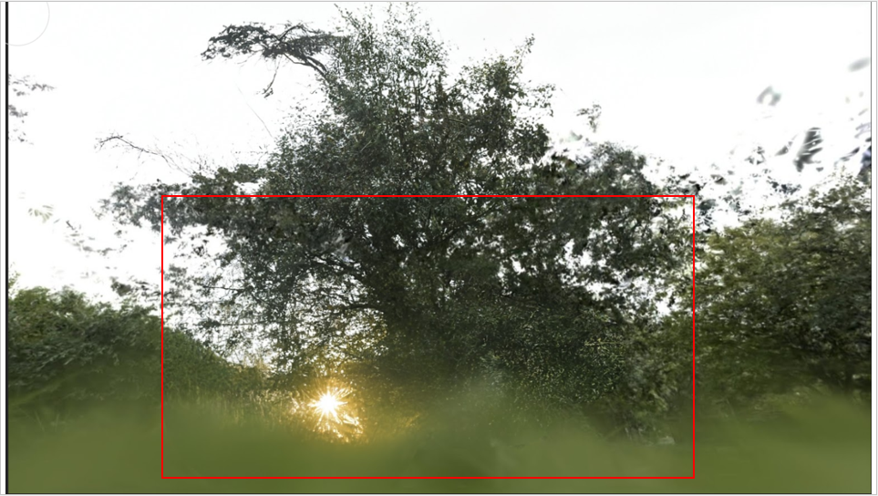
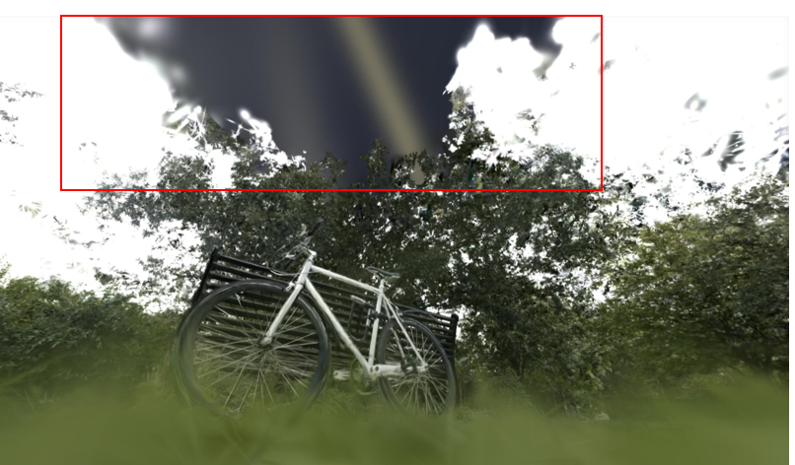
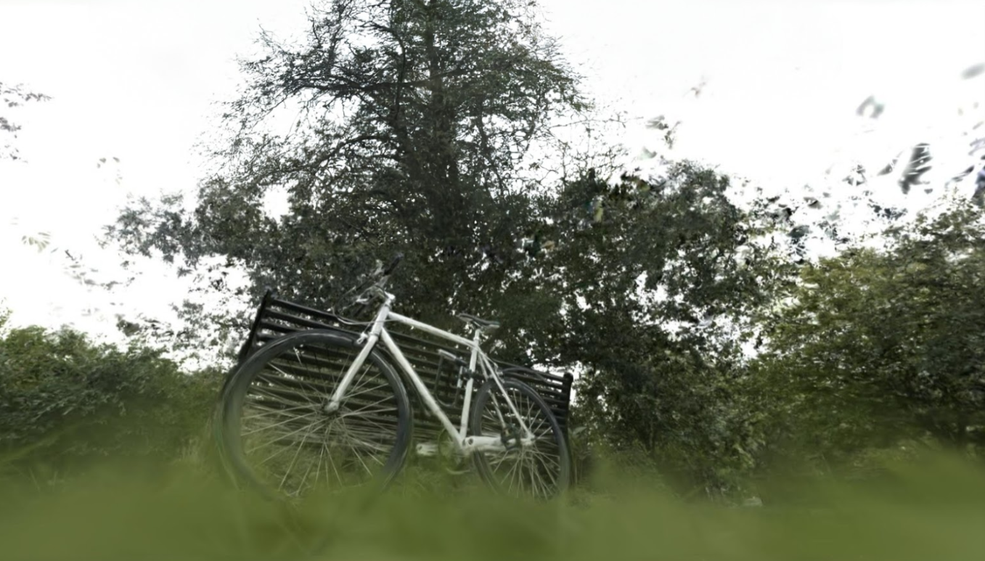
Extension 1 : Fixing with "Inpainting"
« Fill in the black sections »
(Didn’t give satisfactory result)
Input Image
« Fill in the missing black sky » (Improved Result )
Notes:
Presentation:
To address this, we experimented with using generative models like Stable Diffusion in post-processing to fill in these gaps. Initially, a generic prompt like "fill in the missing black sections" led to incorrect results, removing objects like the bicycle. Refining the prompt to focus on context, like "fill in the missing black sky," yielded better results. However, this method is limited to one image at a time and doesn't scale easily.
A more robust solution could involve retraining the 3D gaussian splatting model with these filled images, WHICH could be a promising direction for future research.

Slide 13
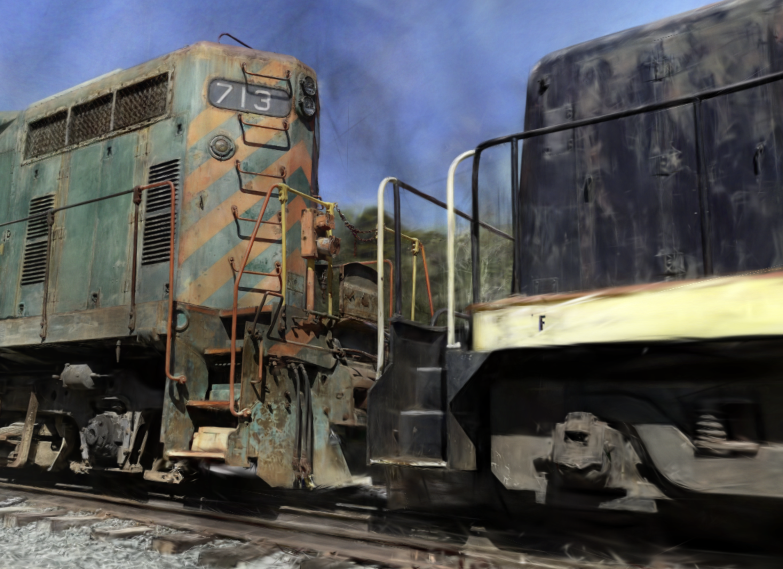
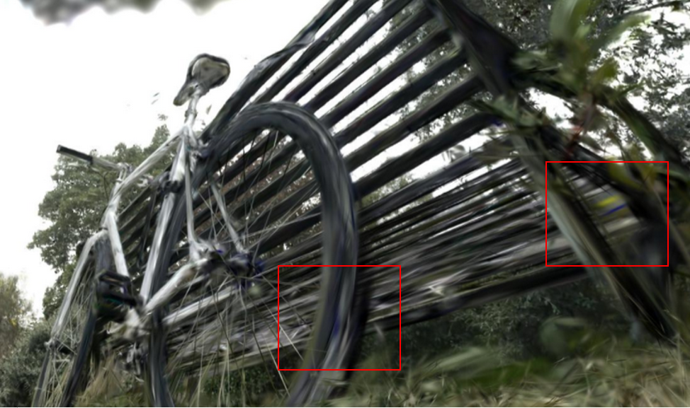
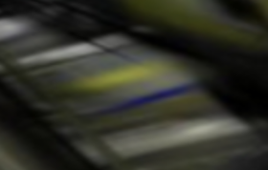
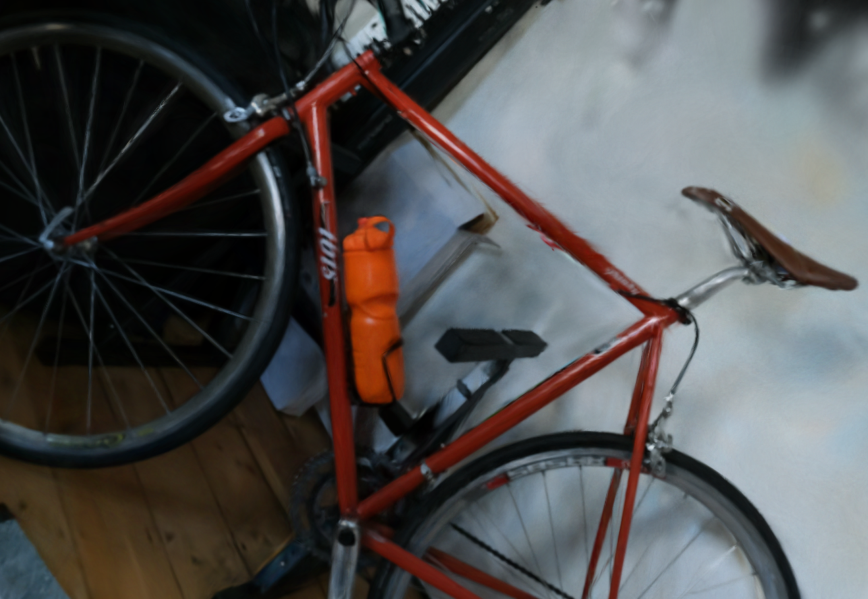
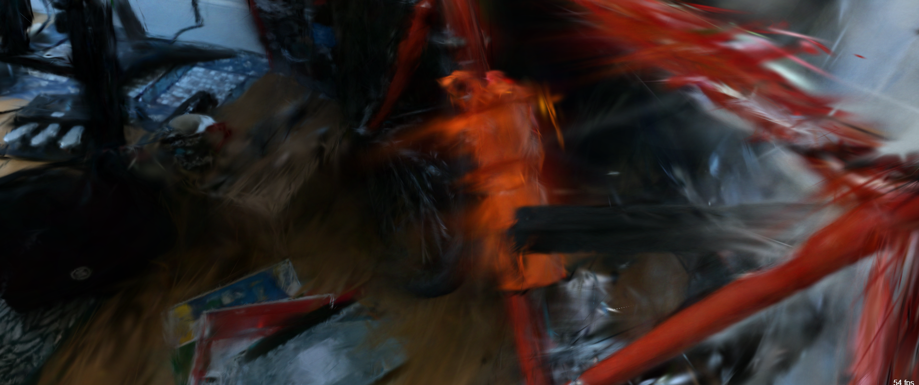
Limitation 2 : Color artifacts
Chromatic aberration
Black Specks
Spherical Harmonics induce blurry artifacts
Notes:
Presentation:Paul
In our tests , when SLIGHTLY changing the view angle we noticed CA , Blurry artifacts and ESPECIALLY the presence of these Black Specs that appear in the rendered image.
We assume these Artifacts may be due to misplacement of some gaussians BECAUSE the algorithm optimizes for specific views meaning the gaussians dont exactly match the real 3D geometry

Slide 14
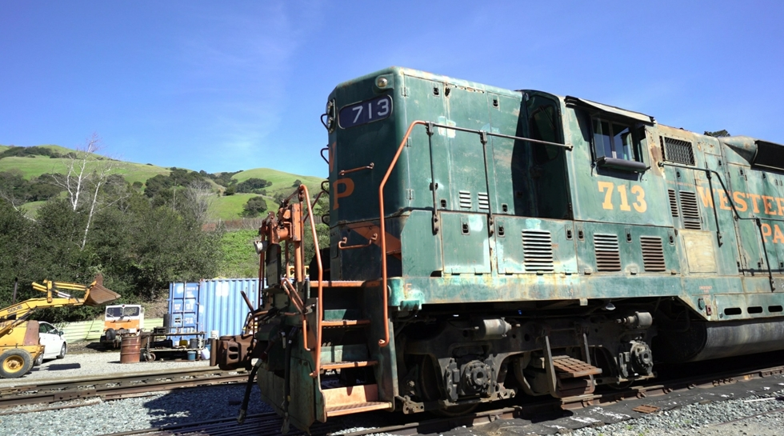
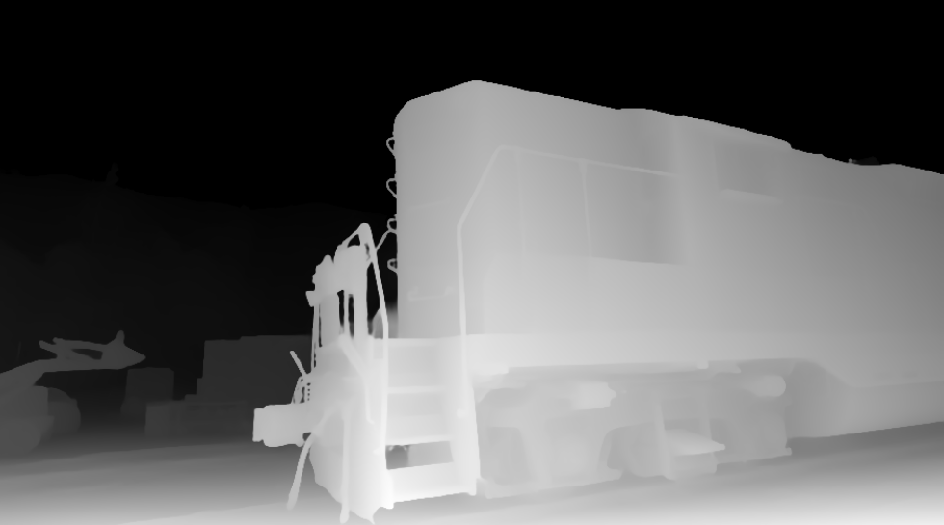
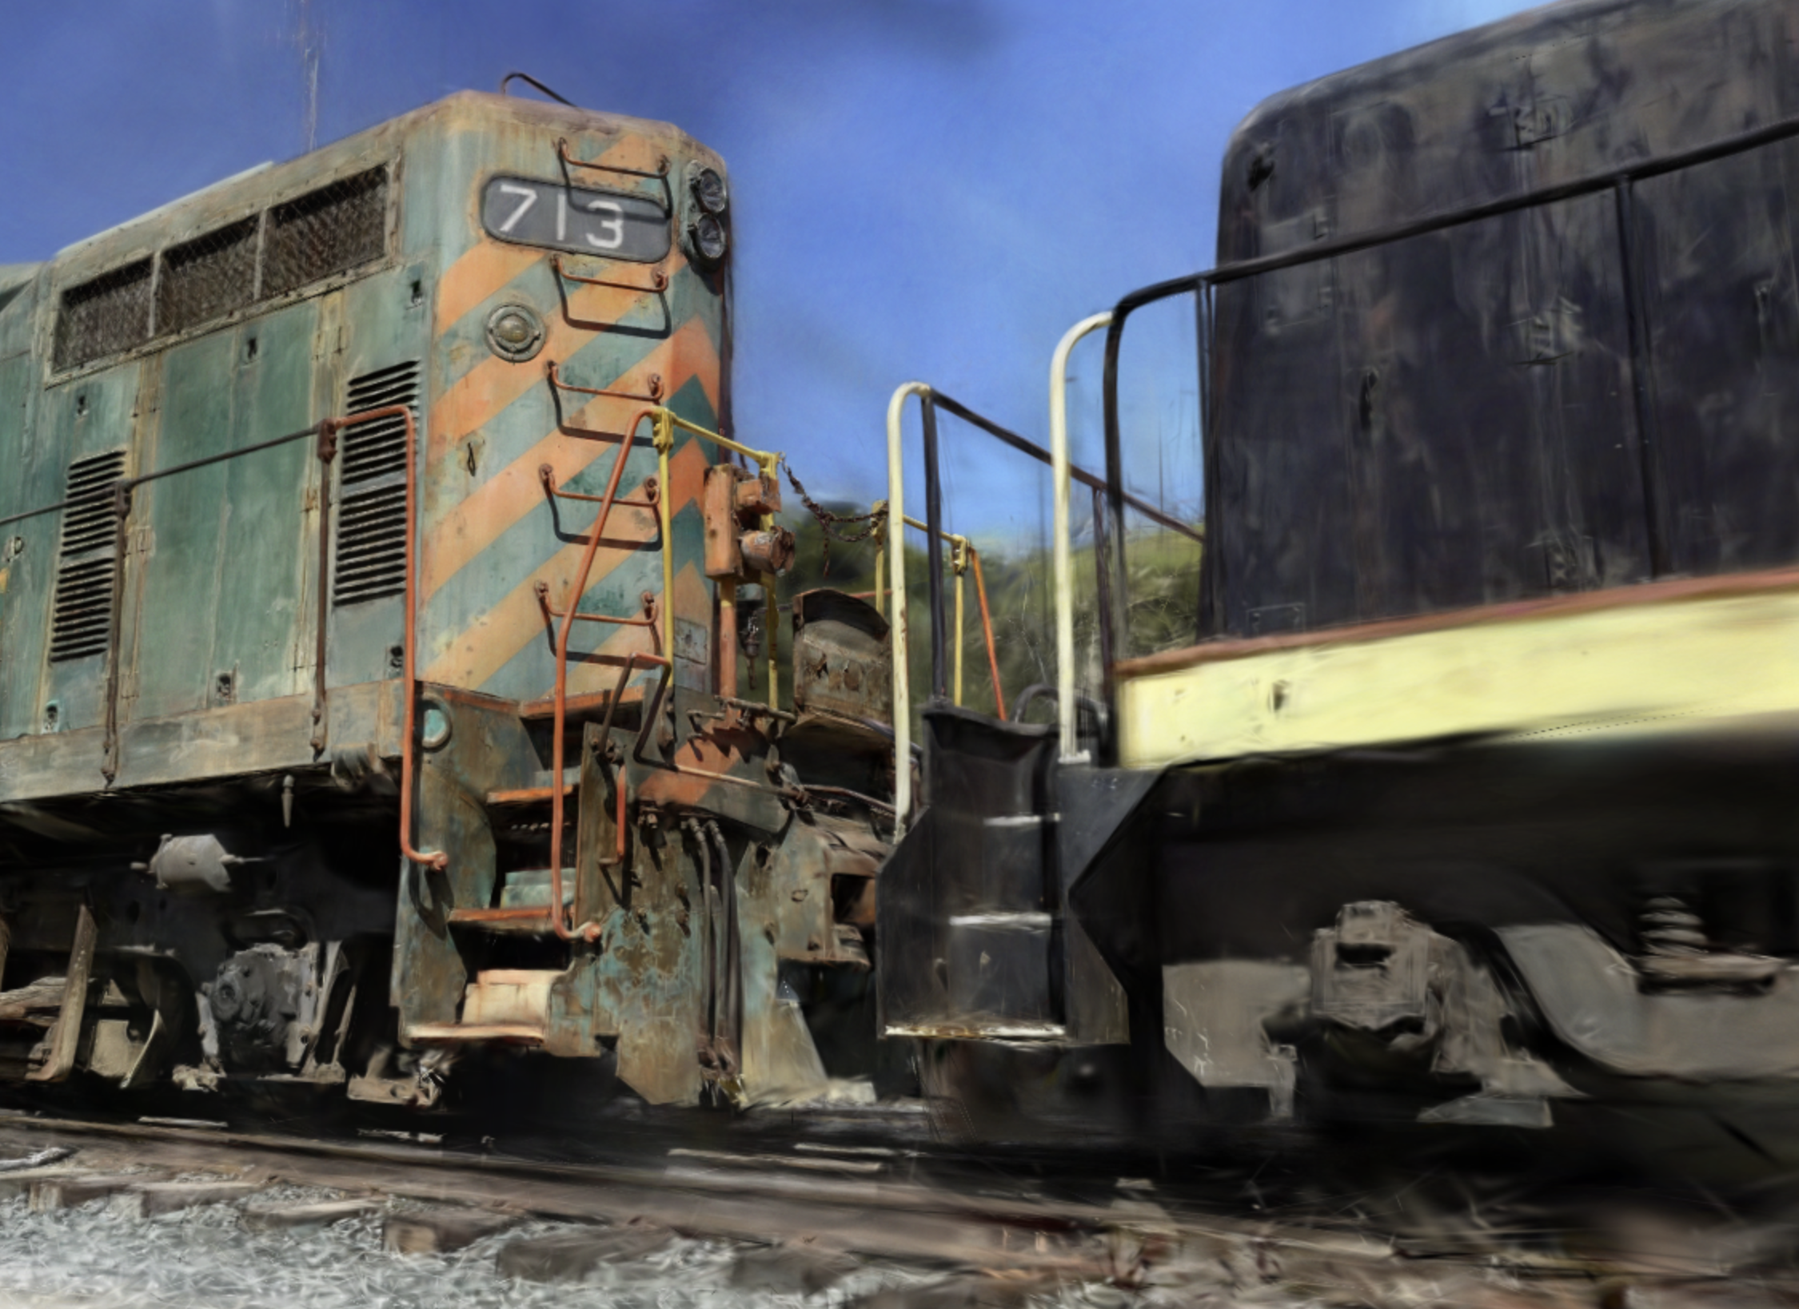
Extension 2 : Adding Depth Regularization
Using a Depth Estimator, (like DepthAnythingv2)
$$L = \left(1 − λ\right)L_{1}+ λL_{\left\{D−SSIM\right\}}+L_{\left\{depth\right\}}$$
Notes:
Presentation:Paul
To avoid guassians misplacement, we can regularize their position using a depth map obtained with a pretrained model.
From this we can add a term to our loss to force the gaussian to have a correct depth with respect to the camera, overall improving their placements.
We observe that it indeed removes the blackspecks

Slide 15
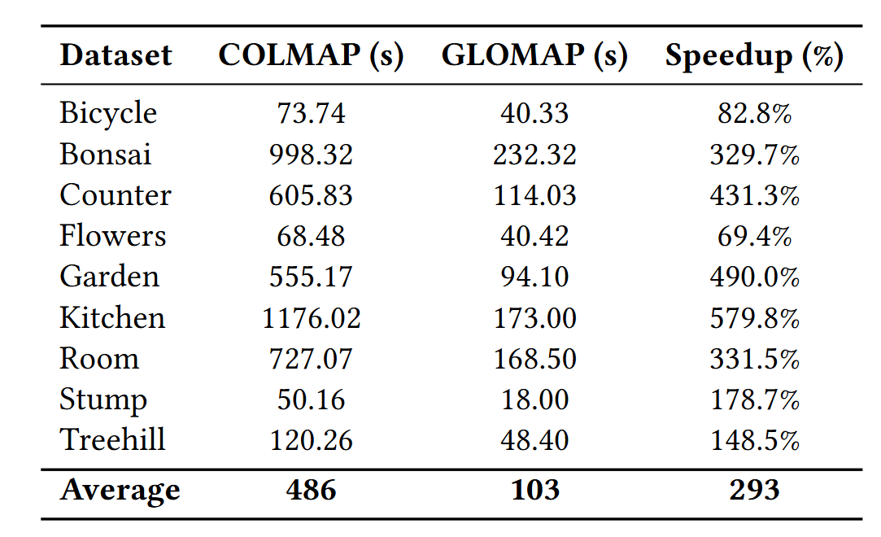
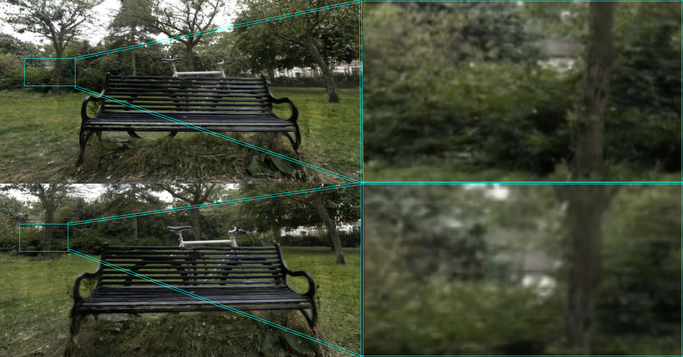
Extension 3 : SFM Comparison CoLMAP/GLOMAP
Colmap
GLOMAP
Qualitative differences in the output of Gaussian splatting with different solvers
GLOMAP is a faster in average SFM solver
Notes:
Presentation: Pierrick
As real-time processing could be needed in situations such as mapping in robotics, we looked where we could improve the initial baseline. As the initial SFM solver provided slow but high quality results, , we plugged a faster implementation, GLOMAP into the 3GS baseline. As observed, we have on average an 300% speedup and if someone is not interested in the background , the faster GLOMAP algorithm could be a viable option.

Slide 16
Conclusion
Limitations | Extensions
Holes due to missing camera views | Fix them with Stable Diffusion
Color artifacts | Depth Regularization
Possible Speed Ups | Compare two SfM algorithm
3D Gaussian Splatting: Revolutionizing 3D Reconstruction
A new paper published almost every day on the topic!
Our Contributions:
Identified key limitations and proposed potential extensions.
Future Directions:
Explore mesh reconstruction.
Investigate temporal Gaussian representations.
Notes:
Presentation: Conclusion
In recent years, 3D Gaussian splatting has rapidly emerged as a groundbreaking technique in the field of 3D reconstruction. The method has gained so much traction that there's nearly a new paper published on it every day. This highlights how quickly the field is advancing and how much potential it holds.
Our work in this area has focused on identifying some of the key limitations of the current techniques as seen in the table. Alongside this, we've proposed several extensions that could help address these challenges and push the field forward.
Looking ahead, there are exciting possibilities. One promising direction is the mesh reconstruction approach, which could help create more robust and detailed 3D models. Additionally, we’re interested in exploring temporal Gaussians, which would allow us to better capture dynamic scenes and motion over time.

Slide 17
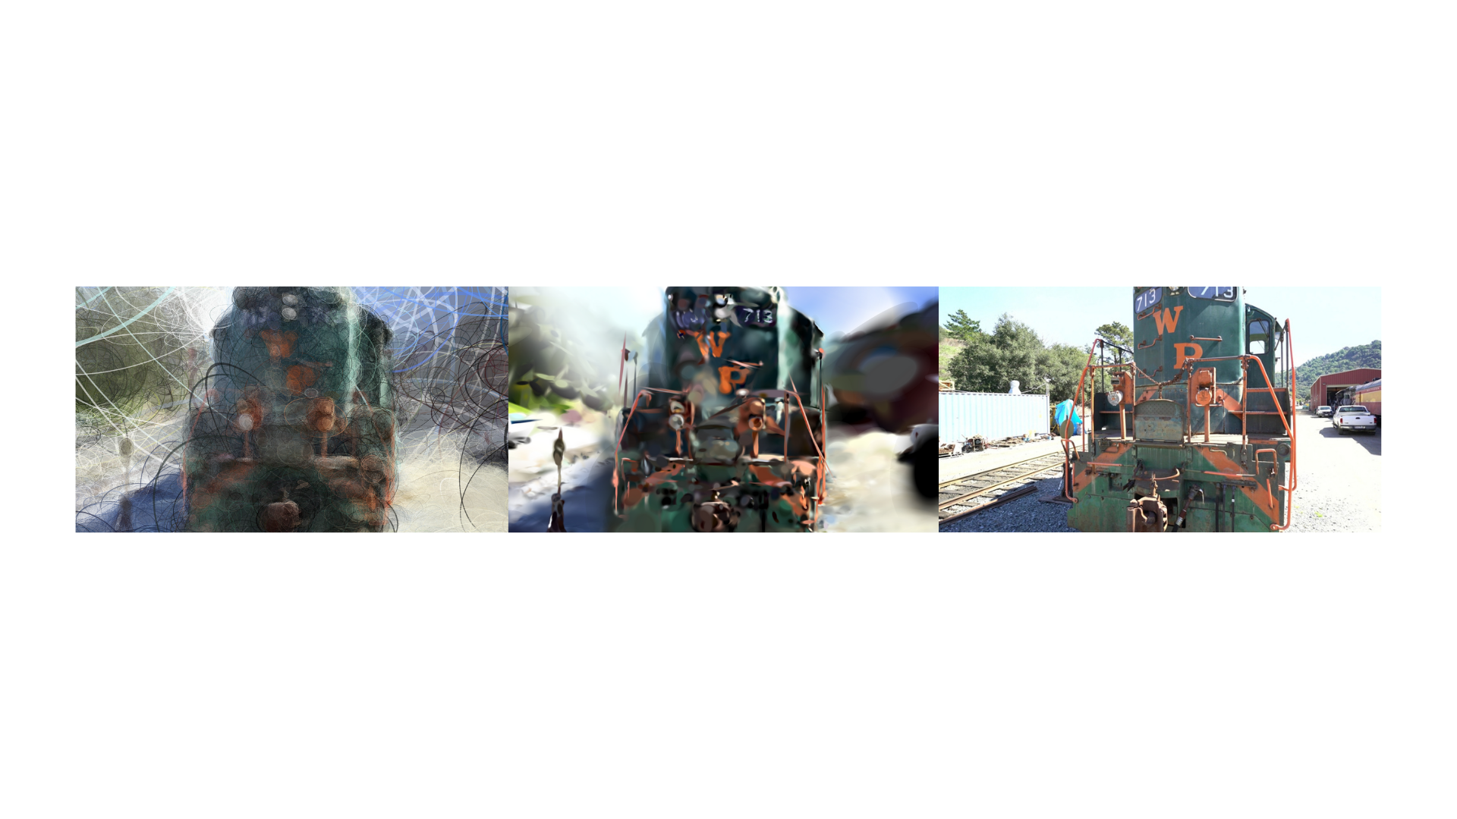
The END ☺
THE END !

Slide 18
UNUSED SHOULD BE REMOVE

Slide 20
Extension 2 : Adding depth regularization
Using a Depth Estimator, (like DepthAnythingv2)
$$L = \left(1 − λ\right)L_{1}+ λL_{\left\{D−SSIM\right\}}+L_{\left\{depth\right\}}$$
Notes:
Presentation:Paul
To avoid guassians misplacement, we can regularize their position using a depth map obtained with a pretrained model.
From this we can add a term to our loss to force the gaussian to have a correct depth with respect to the camera, overall improving their placements.
We observe that it indeed removes the blackspecks

Slide 21
Extension 3 : Some Hyperparameters tuning
Put adding noise or spherical harmonics?

Slide 22
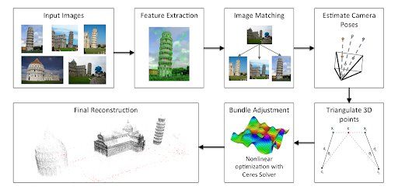
ADditional
Put adding noise or spherical harmonics?

Slide 23
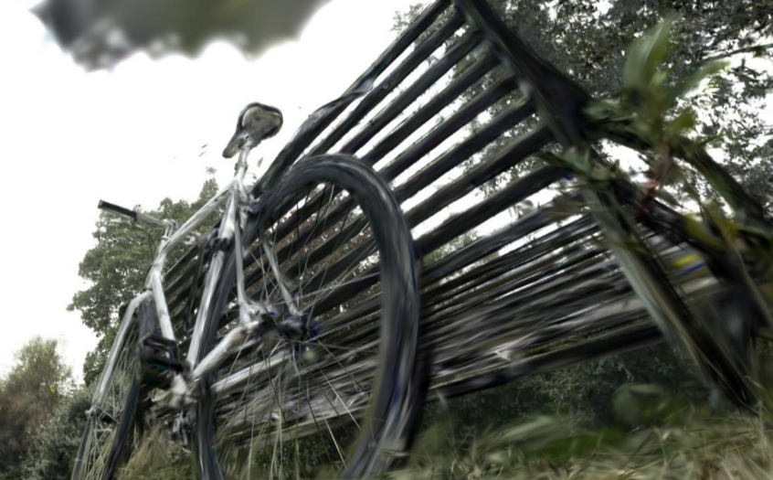
Limitation 2 : Difficulty rendering boundaries PIERRICK:SHOULD BE REMOVED

